Slide 1
None of the planners or speakers for this event have any financial relationships to disclose.

Slide 2


MAINE DEPARTMENT
OF EDUCATION
Educating the Whole Student
Presented by: Commissioner Pender Makin

Slide 3
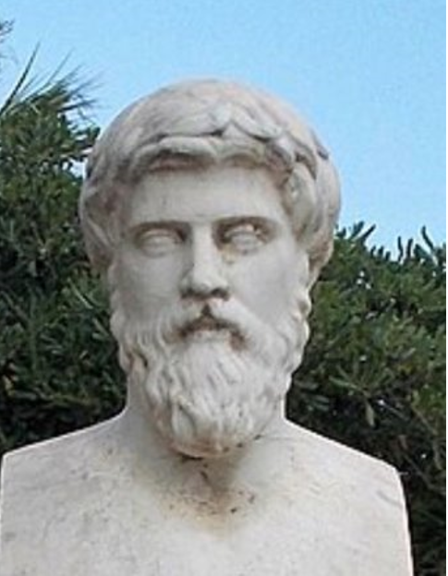
A New Approach?
50-100 AD

Slide 4
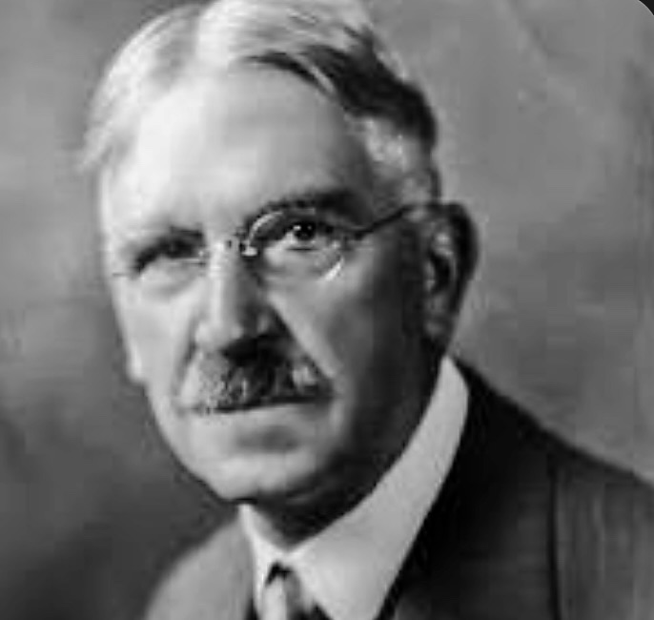
A New Approach?
1899

Slide 5

Education "Reform"
2002

Slide 6


Slide 7


Slide 8


Slide 9
Activate and Maintain Attention
Predict Consequences
Active learning
depends upon a strong PFC.
Delay
Gratification
Prioritize Information

Slide 10



Slide 11

Amygdala's
Evolutionary Training
Hunger =
Social Isolation =

Slide 12
Supports for Building
A Strong PFC
Physical Safety
Emotional Safety
Nutrition, Activity, and Physical Health
Skills for Self-Regulation
Sense of Belonging/Positive Relationships
Coping Skills/Learned Resilience
Challenge, Higher-Order Thinking, and Active Learning

Slide 13
It takes a whole team
to educate the whole student.

Slide 14

The Whole Student Team =
Educators + Nurses + School Physicians + Pediatricians + Counselors + Coaches + Nutrition Staff, etc.

